Slide 1
Msc Karen Guerrero Vazquez
Dr. Katarzyna Whysall
Dr. Pilib O Broin

Slide 2
Computational approaches for the therapeutic target discovery to ame-liorate muscle wasting during aging and disease

Slide 3
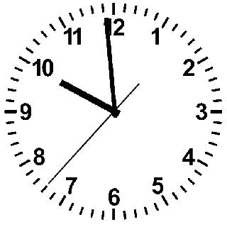
Sarcopenia
Notes:
The ticking of the clock never stops, every moment we get older, and one of the most striking effects of age is probably the involuntary loss of muscle mass, strength, and function. This is called Sarcopenia.

Slide 4
~3 – 8 %
Loss of muscle mass per decade
Brocklehurst, 1976
Notes:
. From the time you are born to around the time you turn 30, your muscles grow larger and stronger. But at some point in your 30s, you start to lose muscle mass and function. No matter the lifestyle, everybody is going to loss between 3 to 8% of muscle mass per decade after age 30, and this rate of decline is even higher after the age of 60. Sarcopenia is associated with detrimental clinical outcomes, such as a reduced quality of life, frailty, an increased risk of falls, fractures, hospitalization, and mortality.

Slide 5
Chronic inflammation
Increased reactive oxygen species
Increased fibrosis of muscle
Increased loss of motor neurons
Yanai, 2020
Notes:
Several factors, including chronic inflammation, increased reactive oxidative species, increased fibrosis of muscle, and increased loss of motor neurons, have been reported to contribute to development of sarcopenia

Slide 6
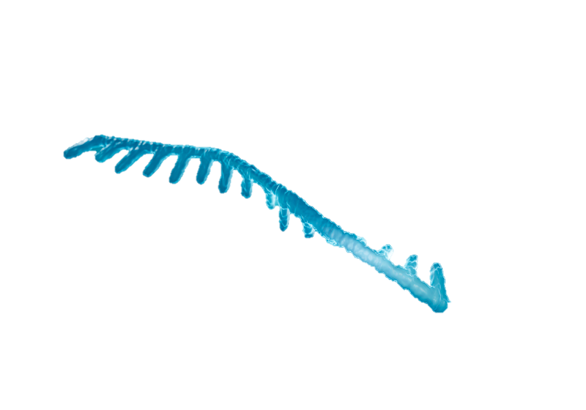
Micro-RNA

Slide 7
non-coding RNAs
regulation of gene expression
14 and 33 nucleotides
Yanai, 2020
Notes:
Mircro RNA or miRNA are conserved small non-coding RNAs that play an important role in the regulation of gene expression, they are short nucleotide single stranded RNAs (ssRNAs), between 14 and 33, with an average of 20 as MirBase suggest today.

Slide 8
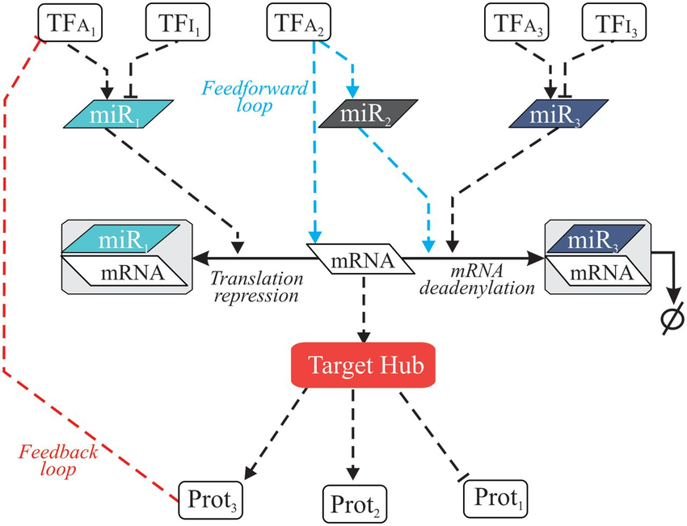
Regulatory Networks
Notes:
It is likely that miRNAs naturally build regulatory networks that control different cellular functions,

Slide 9
Regulatory Networks
Notes:
It is likely that miRNAs naturally build regulatory networks that control different cellular functions,
mathematical representation of a network and it describes the relationship between lines and points

Slide 10
There’s a computer representation of the microRNAs and their interaction that allows the identification of micro RNA for the treatment of Sarcopenia.

Slide 11
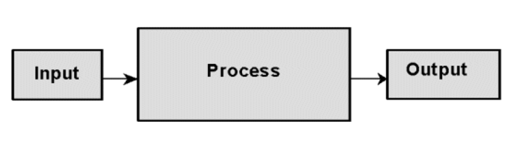
Computational model
?

Slide 12
1.- Define output
2.- Define inputs
3.- Define model

Slide 13
Expected output…
Localize micro RNA with potential as therapeutic for Sarcopenia
Small number (<20) miRNAs for further experimentation
Enough information to understand the working mechanism

Slide 14
Available input…
Available online repositories…

Slide 15
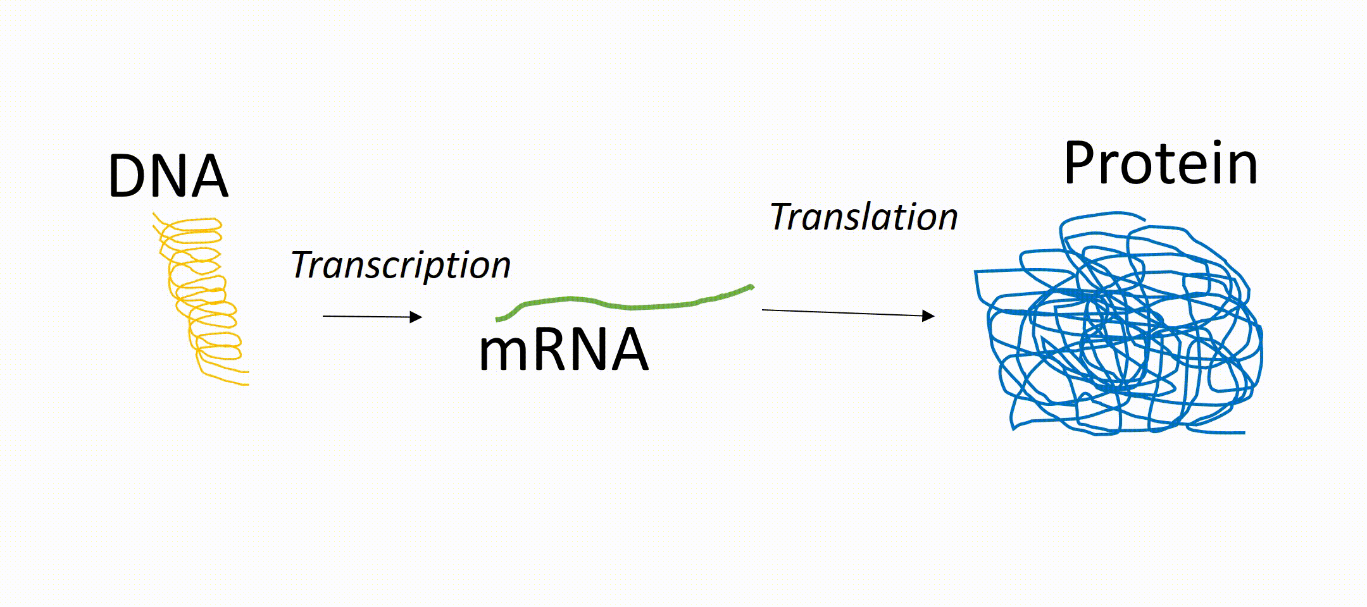
Notes:
What do miRNAs do? They target mRNAs to suppress expression. Then the first relationship that we see is miRNA:mRNA

Slide 16
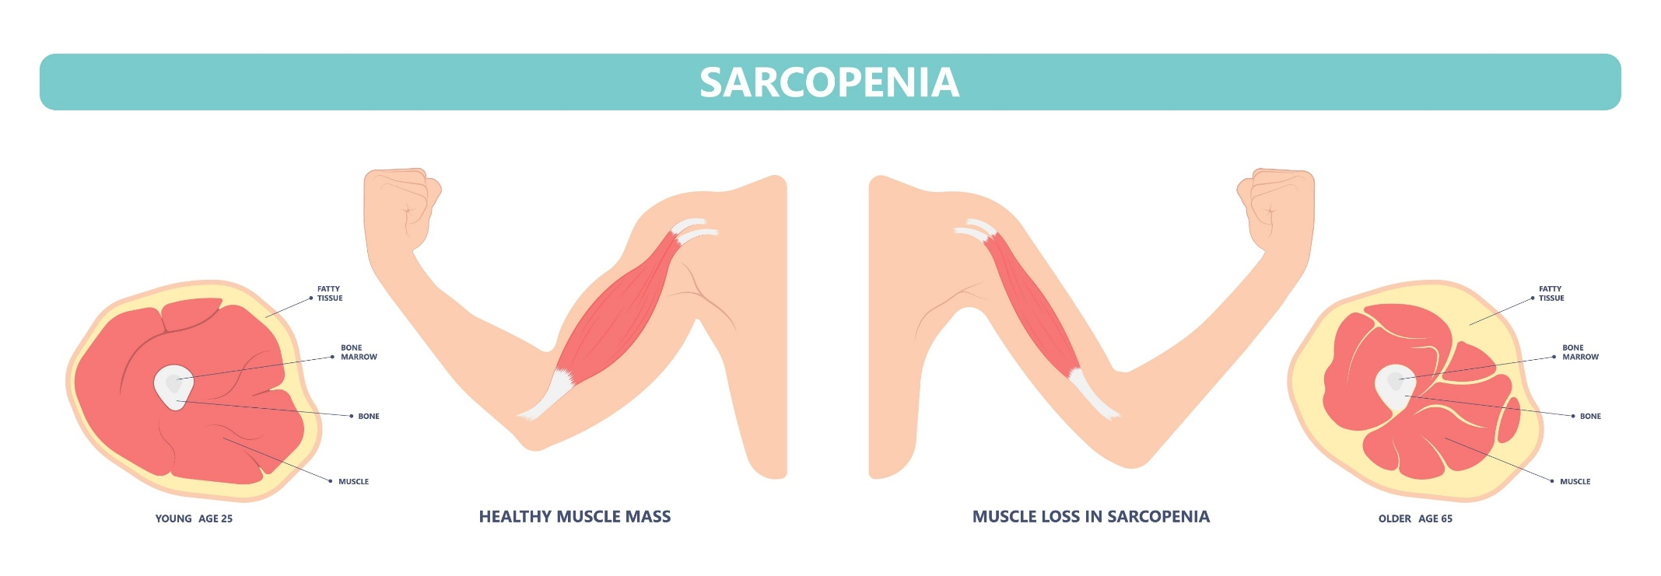
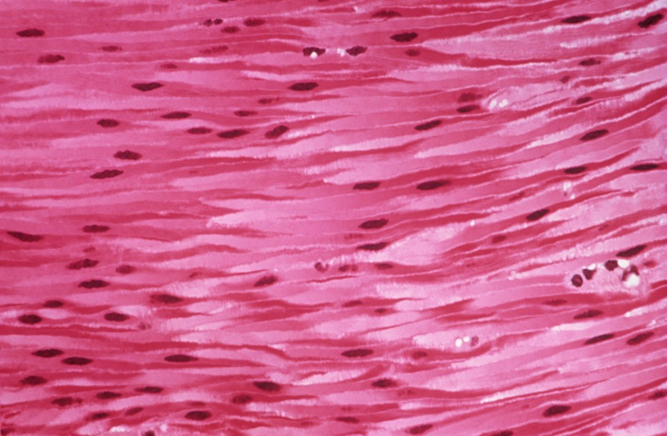
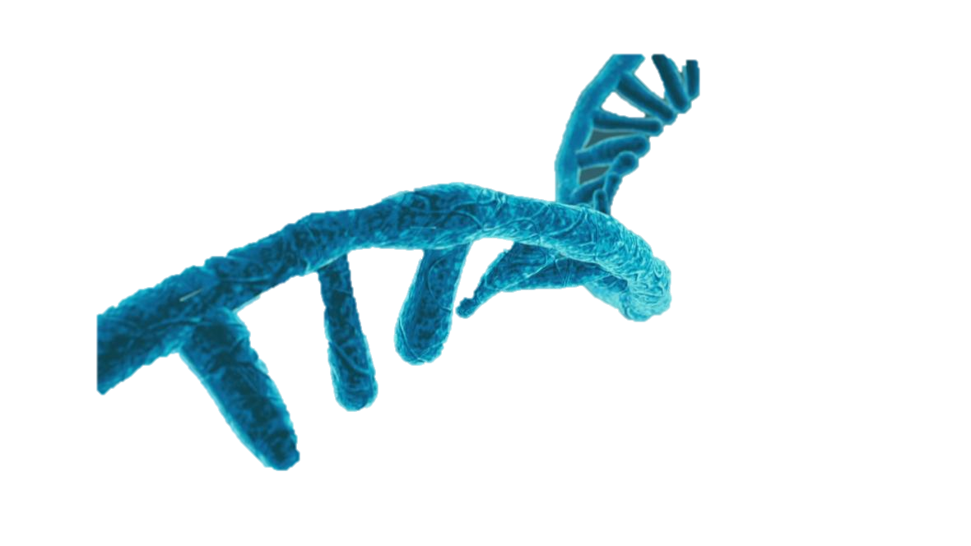
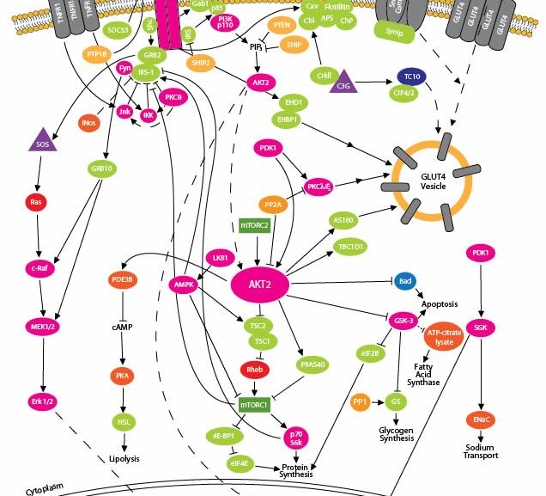

Slide 17

Notes:
We are swimming in a sea of data, the quality of the information is something that is currently under process, from the sources of the data to the value to the project. This will be tuned alongside the design of the network itself.

Slide 18
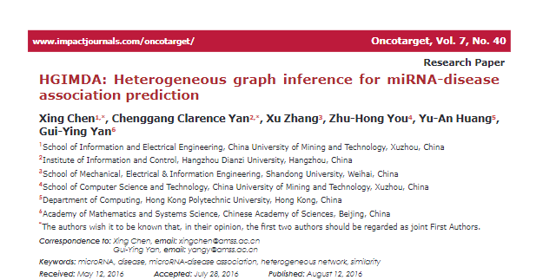
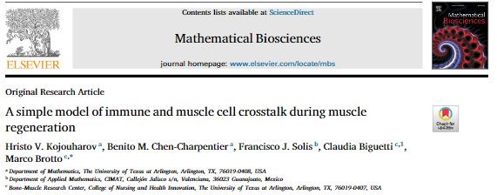
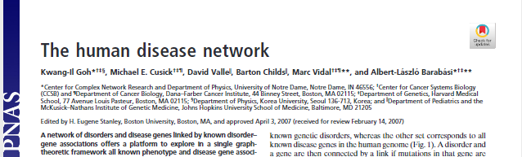
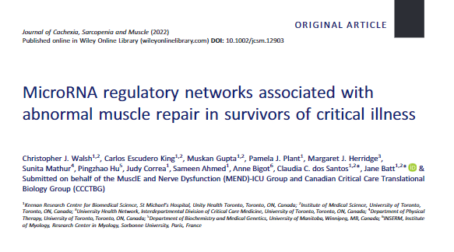
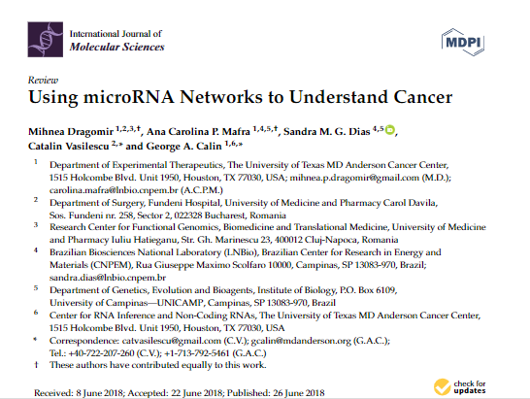
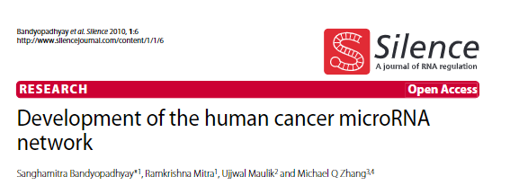
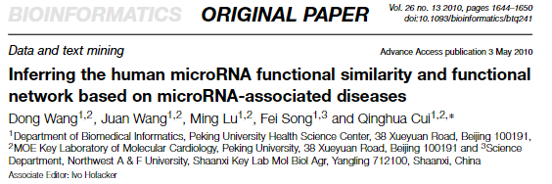
Notes:
Many works had been done in the past to find the influence of micro RNA in different diseases, appealing to different measures and rules.

Slide 19
Planned Methodology

Slide 20
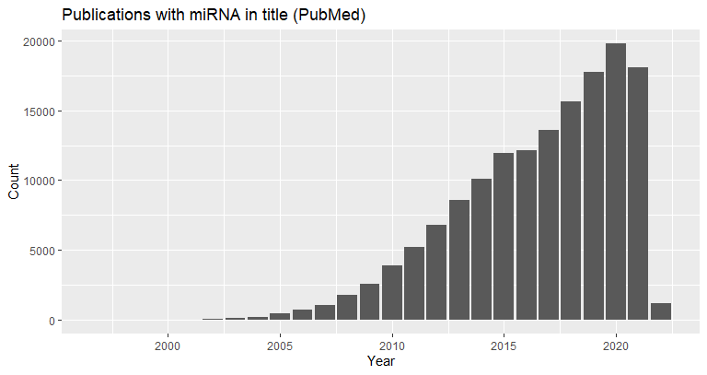







Data collection

Slide 21
Definition of the network
Rules
Relationship
Biological entity 1
Biological entity 2

Slide 22
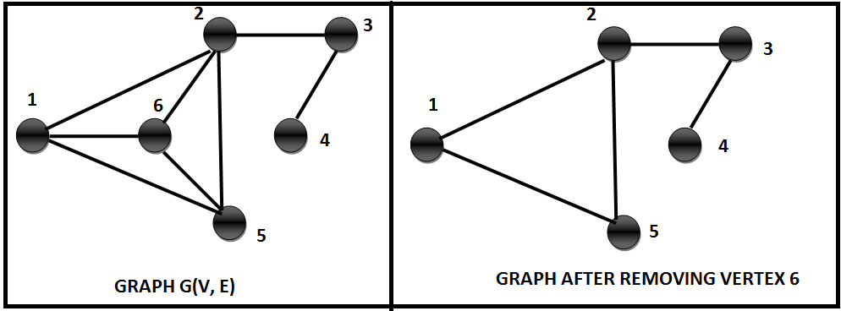

Graph operations
Similarity
Clusters
Centralities

Slide 23
Artifacts
Knowledge
Scale
Clear link
Tuning number of input nodes
High-throughput
Nonsense

Slide 24
Results

Slide 25

My own local database
+
=
25

Slide 26


Tool to standardize gene names
+
Gene names

Slide 27
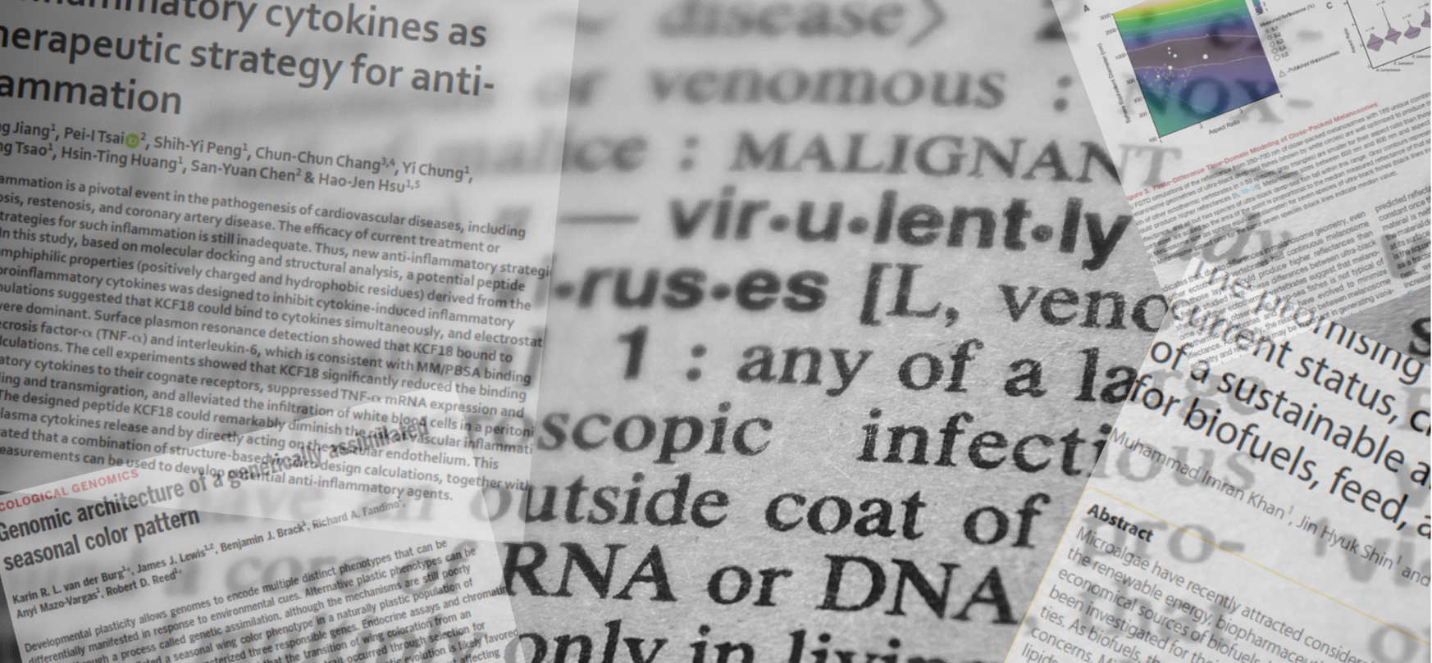

Paper miner

Slide 28
Paper miner
Quick scan of literature
Selecting the best papers
Novelty (year)
Relevance (number of citations)
App Note

Slide 29
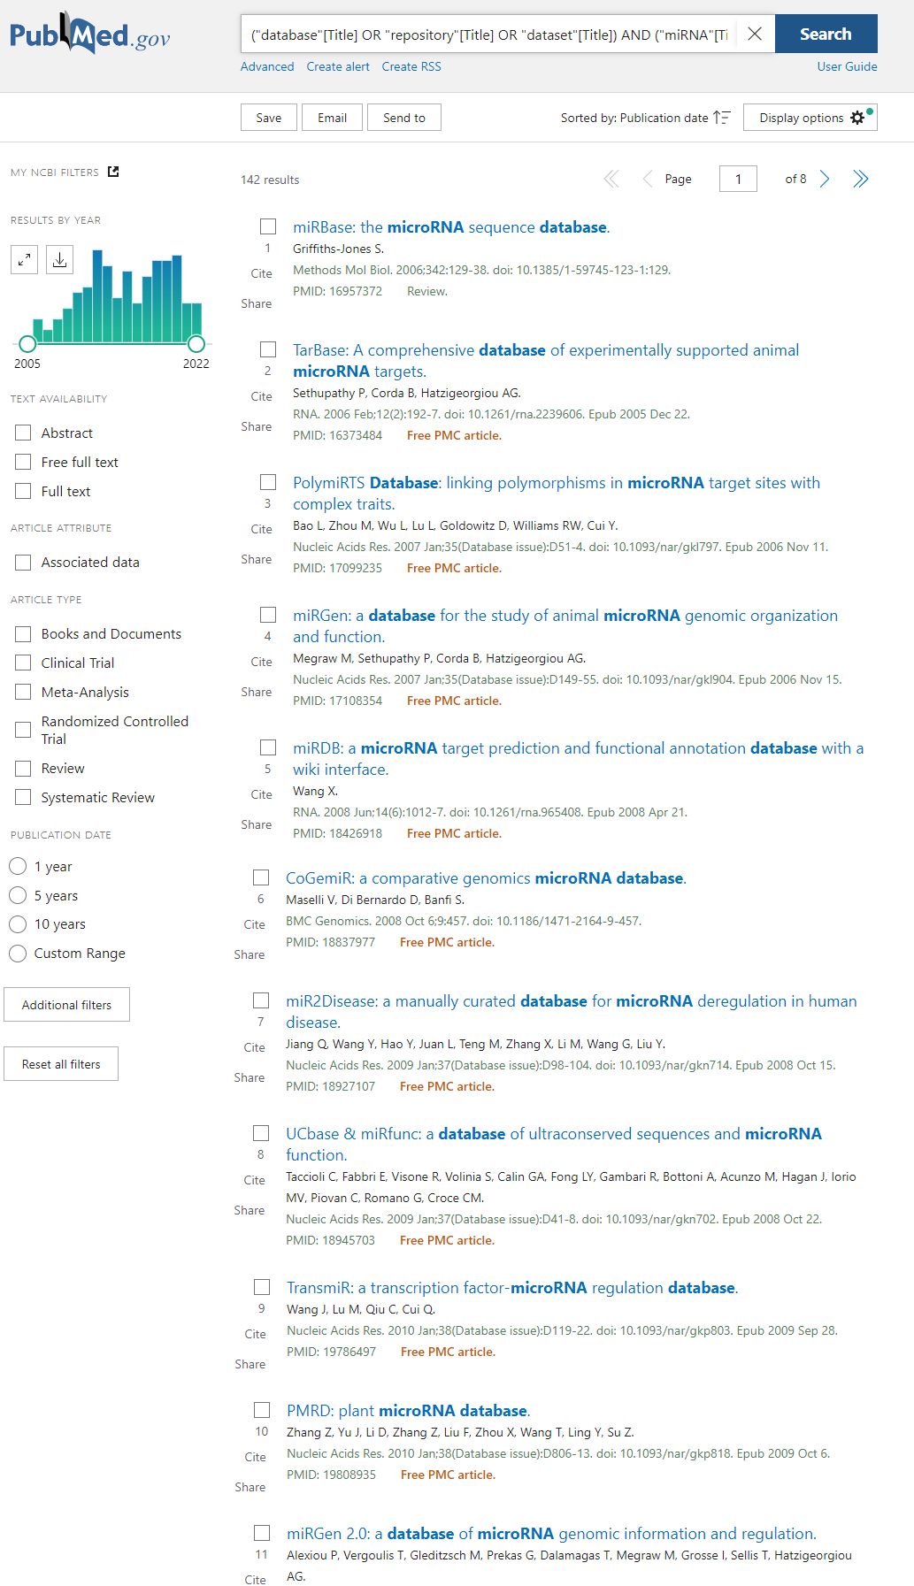
Year publication
Number of citations
Pubmed Query
List of “best” articles
Selection of the articles
("database"[Title] OR "repository"[Title] OR "dataset"[Title]) AND ("miRNA"[Title] OR "microRNA"[Title] OR "micro RNA"[Title])

Slide 30
Multi-objective optimization
Two objectives:
Having the most recent papers
With the most citations
Dominance:
An element that is better than other in all criteria
Pareto set
Set of elements that are not dominated by anyone else

Slide 31
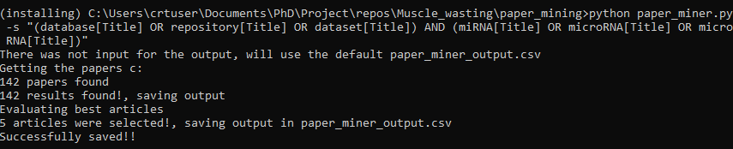
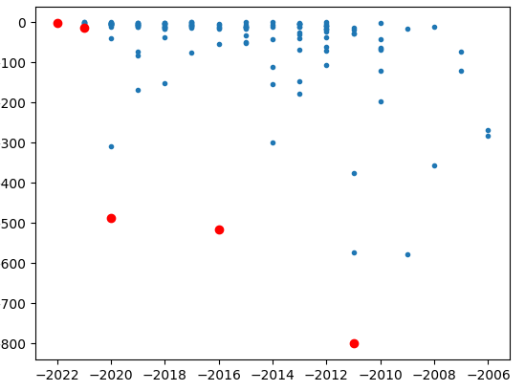
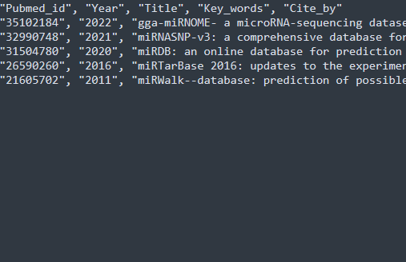

Slide 32
Immediate future work
Use Paper miner to select the literature of Networking on microRNA
Evaluate the strengths and weaknesses on a measurable way (Publication)
Design of the inputs and rules for the network
Construction of the network

Slide 33
Acknowledgements
This presentation has emanated from research conducted with the financial support of Science Foundation Ireland under Grant number [18/CRT/6214 ]

Slide 34
How to select the data?
New
Relevant
Multiple Objective Optimization
PUBMD
Notes:
miRNA are defined as 18 to 25 nucleotide single stranded RNAs (ssRNAs), which are produced from hairpin shaped precursors. They are conserved small non-coding RNAs that play an important role in the regulation of gene expression and participate in a variety of biological processes miRNAs have been found to regulate almost all cellular functions including cell proliferation, growth, differentiation and apoptosis, And as we mention, have been implicated in controlling the fate and behavior of stem cells

Slide 35
How to select the data?
PUBMED
("database"[Title] OR "repository"[Title]
OR "dataset"[Title])
AND
("miRNA"[Title] OR "microRNA"[Title]
OR "micro RNA"[Title])
Notes:
miRNA are defined as 18 to 25 nucleotide single stranded RNAs (ssRNAs), which are produced from hairpin shaped precursors. They are conserved small non-coding RNAs that play an important role in the regulation of gene expression and participate in a variety of biological processes miRNAs have been found to regulate almost all cellular functions including cell proliferation, growth, differentiation and apoptosis, And as we mention, have been implicated in controlling the fate and behavior of stem cells

Slide 36
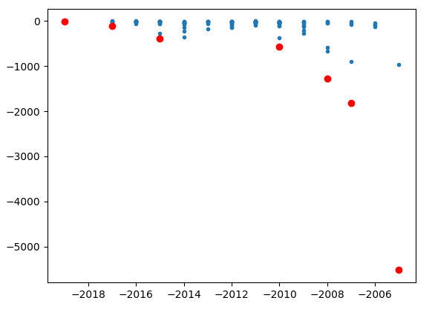
How to select the data?
Notes:
miRNA are defined as 18 to 25 nucleotide single stranded RNAs (ssRNAs), which are produced from hairpin shaped precursors. They are conserved small non-coding RNAs that play an important role in the regulation of gene expression and participate in a variety of biological processes miRNAs have been found to regulate almost all cellular functions including cell proliferation, growth, differentiation and apoptosis, And as we mention, have been implicated in controlling the fate and behavior of stem cells

Slide 38

miRNAs
Notes:
And we can implement the concept of distance and interconnection in order to interpret the impact of an miRNA.

Slide 39
Tissues
Notes:
And we can implement the concept of distance and interconnection in order to interpret the impact of an miRNA.

Slide 40
Conditions
Notes:
And we can implement the concept of distance and interconnection in order to interpret the impact of an miRNA.

Slide 41
Notes:
And we can implement the concept of distance and interconnection in order to interpret the impact of an miRNA.

Slide 42
Similarity
Cliks
Notes:
And we can implement the concept of distance and interconnection in order to interpret the impact of an miRNA.

Slide 43
3
2
Distance
1
Notes:
And we can implement the concept of distance and interconnection in order to interpret the impact of an miRNA.

Slide 45
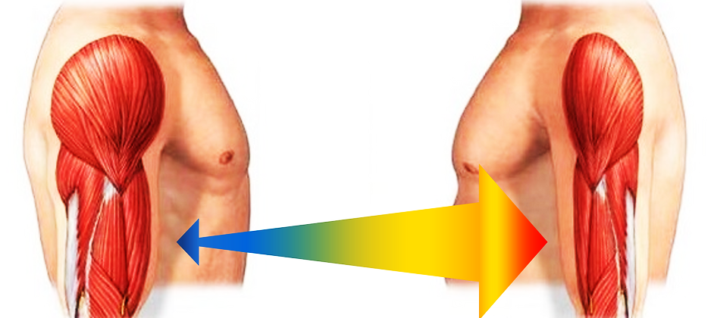
Notes:
One of the most striking effects of age is the involuntary loss of muscle mass, strength, and function, termed sarcopenia.

Slide 46
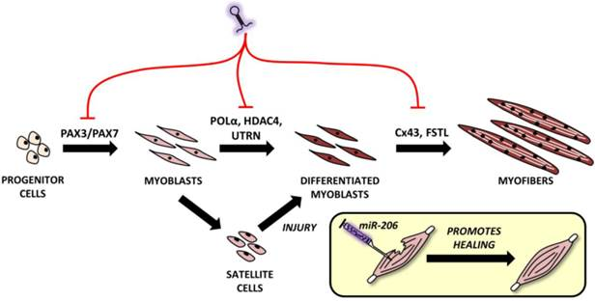
myomirs
Notes:
Muscles express their own set of muscle-enriched mirnas known as myomirs: mir1, 206, 208, 133, 486, 499.

Slide 47
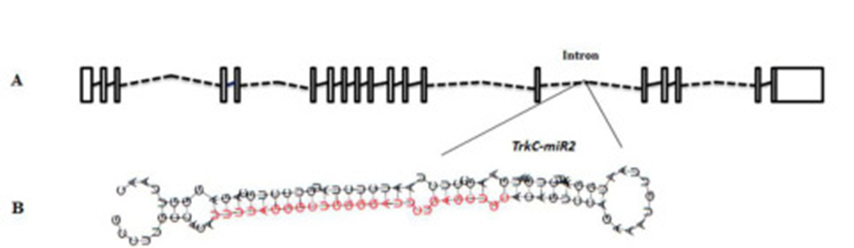
What is a miRNA
18-25 nt single stranded
conserved small non-coding RNAs
regulate almost all cellular functions
cell proliferation
Growth
differentiation
fate and behaviour of stem cells
Notes:
miRNA are defined as 18 to 25 nucleotide single stranded RNAs (ssRNAs), which are produced from hairpin shaped precursors. They are conserved small non-coding RNAs that play an important role in the regulation of gene expression and participate in a variety of biological processes miRNAs have been found to regulate almost all cellular functions including cell proliferation, growth, differentiation and apoptosis, And as we mention, have been implicated in controlling the fate and behavior of stem cells

Slide 48
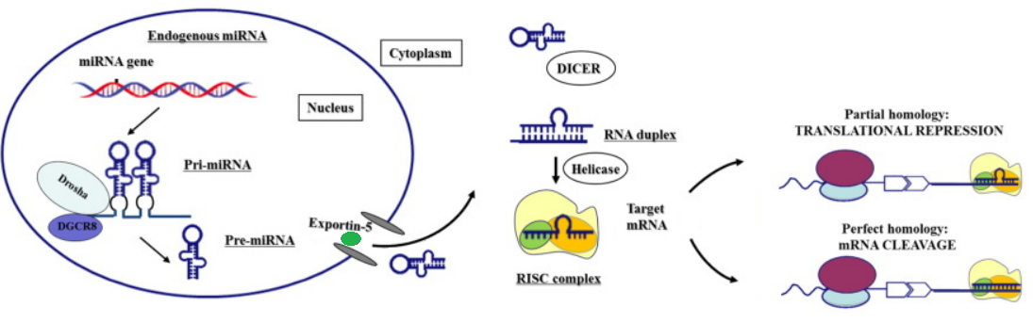
miRNA genesis
Notes:
Modified from https://www.thelancet.com/article/S2352-3964(16)30423-6/fulltext

Slide 49
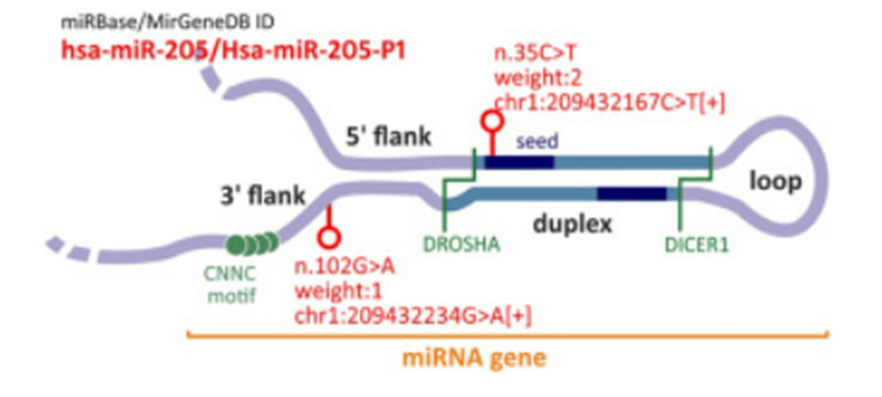
Notes:
https://www.sciencedirect.com/science/article/pii/S2666166721007292

Slide 50
Evolution of miRNA study
miRNAs fall into the class of RNAibased therapeutics
1,120,000 Academic Google
134,677 in PubMed

Slide 51
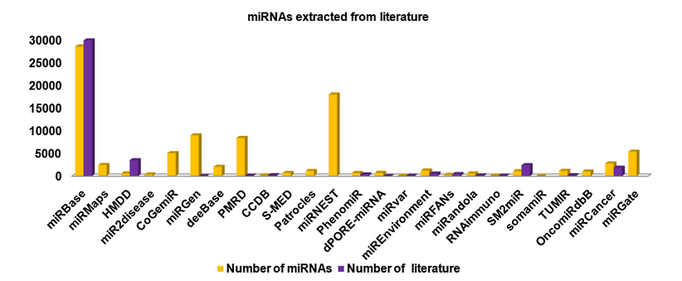
Number of miRNA in some DB

Slide 52
Garbage in, garbage out (GIGO)
Garbage data
Most amazing Data Science project ever
Garbage results

